Slide 1
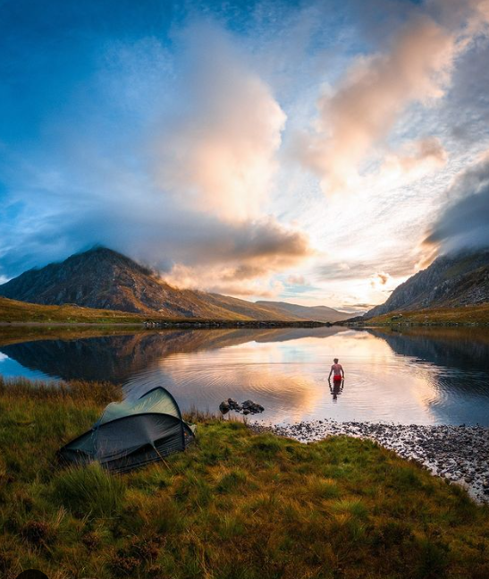
MyTrip
Username:
Password:
Come in!

Slide 2
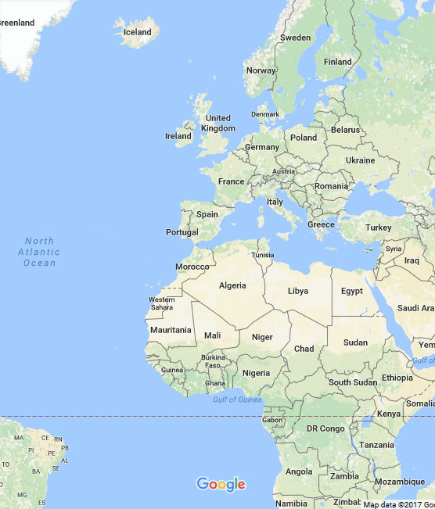
MyTrip
Add new trip
My Trips

Slide 3
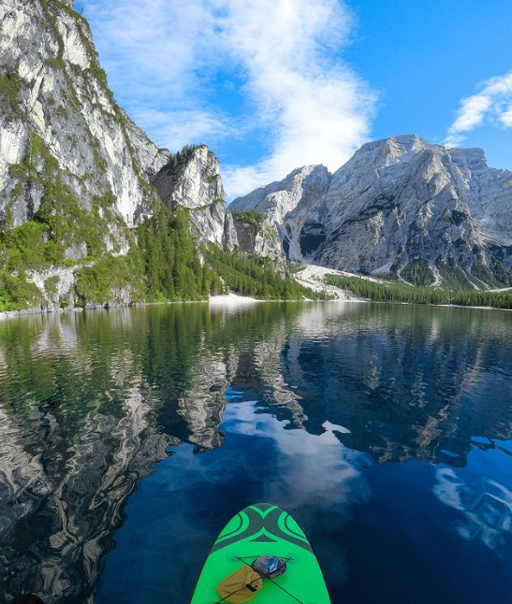
Back
MyTrip
My Trips:
London 2020
Paris 2018
New-York 2015
Eilat 2012
South Africa 2011

Slide 4
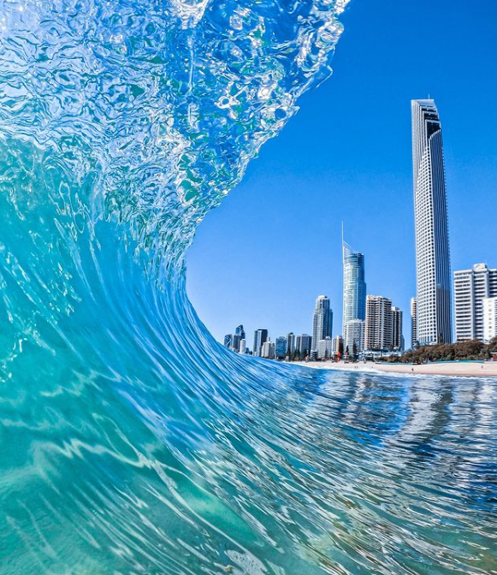
Cancel
MyTrip
Destination:
___________
Activity 1:
___________
PREV
Description
__________________________________________
NEXT
Photo
Done

Slide 5
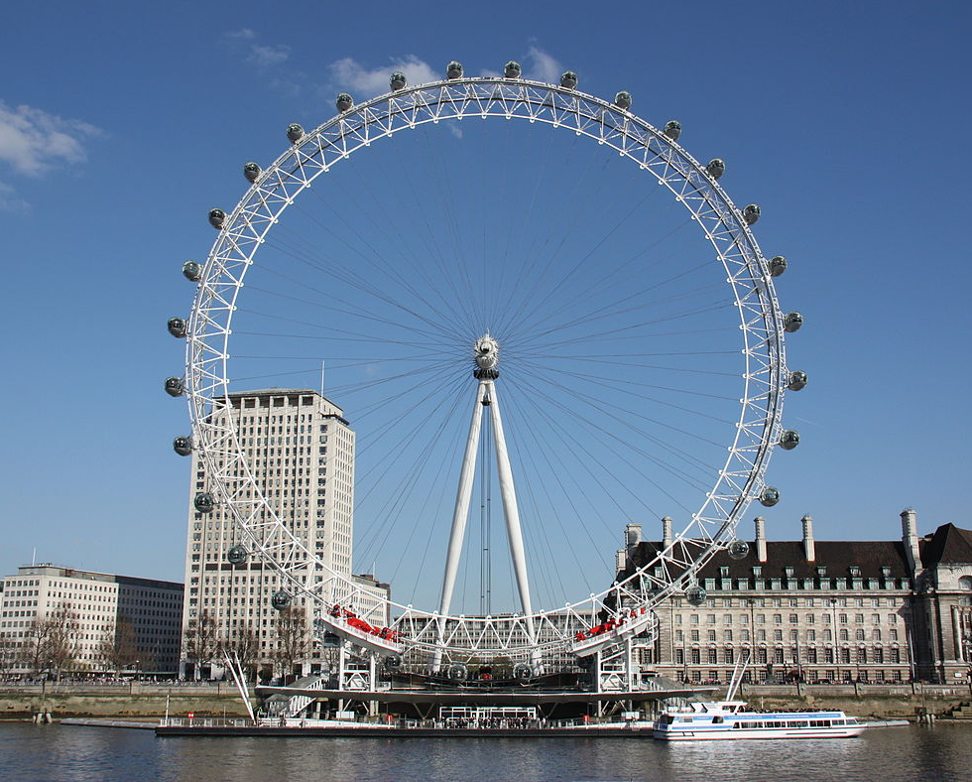
Cancel
MyTrip
Destination:
London
Activity 1:
London eye
PREV
Description
A huge giant wheel, it is recommended to book tickets in advance
NEXT
Done

